Slide 1
Exchange of Materials
Year 11 Human Biology
ATAR
PowerPoint #5

Slide 2
SCSA Syllabus Reference
Factors affecting the exchange of materials across the cell membrane include surface area to volume ratio, concentration gradients, and the physical and chemical nature of the materials being exchanged

Slide 3
Lesson Intention
To describe how different factors affect the exchange of materials across the cell membrane
To explore how SA: Vol Ratio limits cell size

Slide 4
Success Criteria
identify the different factors affecting the exchange of materials
describe how the different factors each affect the exchange of materials
explain how cells are so small
calculate the surface area of cells

Slide 5
Vocabulary
Surface Area to Volume Ratio: the amount of surface area per unit volume of an object or collection of objects

Slide 6
Cell Size
Most cells are incredibly small, between 10 and 15 micrometres (µm) in diameter.
A micrometre is one-thousandth of a millimetre.
There is a limit to how big a cell can be. All the requirements and products of a cell must pass across the membrane that surrounds the cell.

Slide 7
Factors affecting material exchange
Factors affecting the exchange of materials across the cell membrane include
Surface area to volume ratio
Concentration gradient
Physical and chemical nature of materials being exchanged

Slide 8
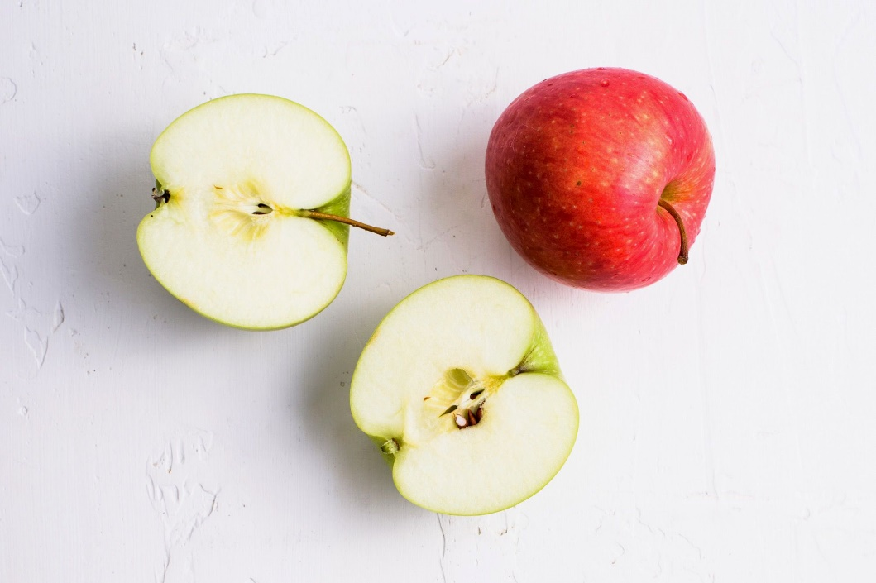
Surface Area
The relationship between the surface area of the cell and the volume is very important.
As the apple is cut in half the surface area increases.
If you continue to cut the apple into small
pieces, the surface are to volume ratio of
the pieces gets bigger and bigger.

Slide 9
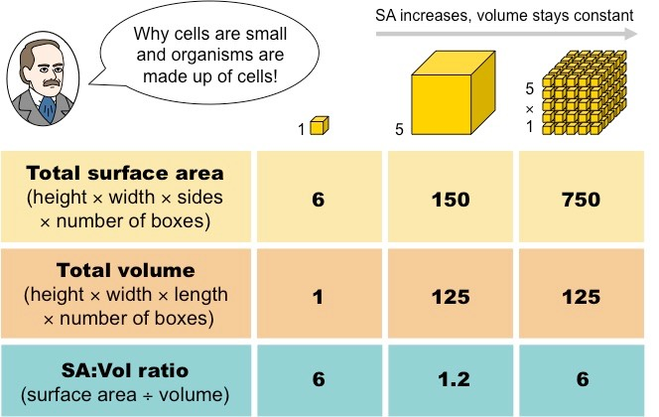

Slide 10
Concentration gradients
A concentration gradient results from the unequal distribution of particles.
Particles may move along or against their concentration gradient.

Slide 11
Physical and chemical nature
Physical: the size of the particle being exchanged e.g. glucose needs channels
Chemical: refers to the polarity of ions and how they are unable to move freely.

Slide 12
Recall Knowledge
Would you expect the cells of a large mammal, such as an elephant, to be larger than those of a small mammal, such as a mouse?
Explain your answer.

Slide 13
Apply Knowledge
Why do cells need to be small?

Slide 14
Homework
None for today ☺

Slide 15
Reading
Pages 40 (bottom half) - 41: Movement within the cell
Why are cells so small?

